Slide 1
WEIGHTED AVERAGE
Weighted Average gives more weight to the more important segments of data.
In this fictitious example PL Direct has the
most policies, so it should be given the most
weight.
.
An Unweighted Average assumes each
Business Unit has the same importance.
Often people want to use the “average of averages” because it sounds good. But they are assuming all segments have the same weight and that is generally not a valid assumption.
Notes:
Walk through Loss Ratio Example in Excel file: Weighted Average 1.

Slide 2
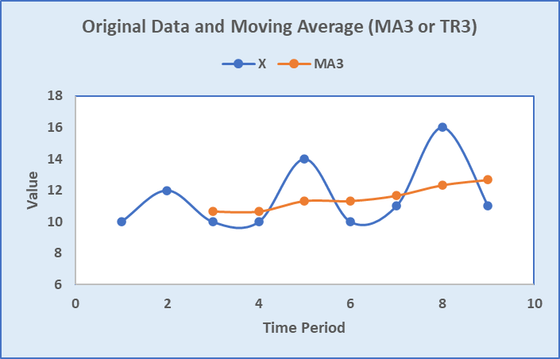
MOVING AVERAGE MAn or TRn where n = # of data points
The two purposes of a Moving Average are to
smooth out fluctuations in the data and
remove seasonality (usually MA12 or TR3) to show trend
Notes:
Analysts are consistently asked, year over year – how did it change?
What would happen if May was 32,000 and October was 23,000? A: 28% decrease.
This is a good time to show that a 50% decrease (from 32,000 to 16,000) requires a 100% increase to get back to where you started. Use excel tab.

Slide 3
GROWTH RATE
Growth Rate is the percent change of a quantity from start to end of a time period. It can be positive or negative. There are 2 ways to calculate it. You should be familiar with both.
Notes:
Analysts are consistently asked, year over year – how did it change?
What would happen if May was 32,000 and October was 23,000? A: 28% decrease.
This is a good time to show that a 50% decrease (from 32,000 to 16,000) requires a 100% increase to get back to where you started. Use excel tab.

Slide 4
GROWTH RATE
Caveat: It really doesn’t make sense to calculate the growth rate if the starting and ending values are of opposite signs (one is positive and one is negative). However, we still do it in PGR.
Notes:
Analysts are consistently asked, year over year – how did it change?
What would happen if May was 32,000 and October was 23,000? A: 28% decrease.
This is a good time to show that a 50% decrease (from 32,000 to 16,000) requires a 100% increase to get back to where you started. Use excel tab.

Slide 5
INDEXING
Divide all the numbers in a series by the first number. This sets the first number equal to 1.00
Then multiply the newly created numbers by 100. This creates an Indexed Series.
Example: Economic series (CPI, PPI)
Q1 Q2 Q3 Q4
87 95 108 120
1.00 1.09 1.24 1.38
100 109 124 138
Why do we create an index? Because it is easy to interpret:
Q2 is 9% higher than Q1
Q4 is 38% higher than Q1

Slide 6
REBASING AND RELATIVITIES
Rebase: Divide the base (reference number) by itself. This sets the Base = 1.00
Relativities: The ratios of other numbers to the base.
Many reports at PGR use “Loss Ratio Relativities” or “Pure Premium Relativities”.Here is an example where we re-base to the Total Combined Ratio (CR) and calculate relativities.
Combined Ratio is (1 – Profit Margin) and is a metric used in insurance.
Indexing is basically re-basing to the first term of the series of numbers.

Slide 7
EXCEL EXERCISES
Go to the Excel exercises. Answers are to the far right on each tab.
Tabs
WtdAvg
MovAvg
Growth Rate
Index
Rebase

